Slide 1

SOLUTION AND DESIGN ARCHITECTURE
CGC_REBOUNDER

Slide 2
Formulae
Rotation Per minute = pressure (pi)
time passed
So if our pipe were pouring fluid into a container, then the instantaneous rate of flow would be the derivative with respect to time of the total volume accumulated in our container.
We see that the rate of flow doesn’t particularly depend upon the length of our pipe.
That is, any section of the pipe has the same instantaneous rate of flow as any other section, whether it be located elsewhere or have different length.
So we might as well say we are talking about the rate of flow through a cross section of the Turbine, i.e. the rate of flow through a perfectly flat cross-section perpendicular to the pipe’s central axis

Slide 3
ALGORITHM
Basically It works on the Basic Functionality of Turbine as well as Fuel Gauge(for initial data )
We just have Club Up their Functionality with HC 05 which shows the Output in our screen
Flow meter Function is embedded on the GRID
As well as Fuel gauge inside the tank is attached with HC 05 to provide the initial amount of Volume in our tank

Slide 4
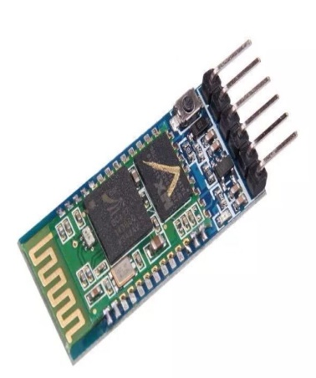
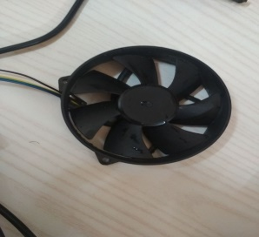


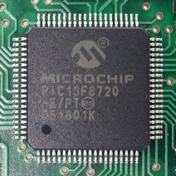
ARCHITECTURE DESIGN
Secure communication
Secure communication
USER
Pcal

Slide 5
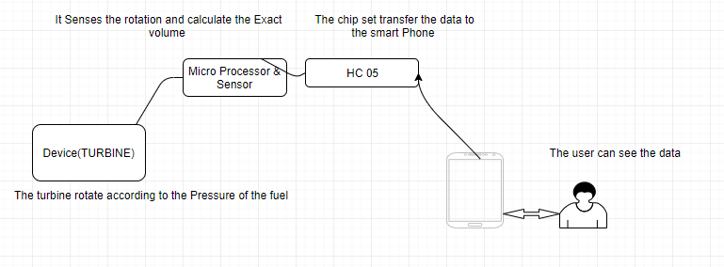
DATA MODEL

Slide 6
WORKING
Open The App And Click On Start
Sharing Of Data
Android API
Bluetooth API
HC-05
Embedded system data
Fuel Gauge
Pair The Device
Collecting The Data

